Slide 1

Heart Attack analysis Group Details: BALA KRISHNA REDDY RAGANNAGARI Jagadeeshwar Kalyanapu

Slide 2

Introduction
Aim: Our project aims to leverage this data to identify patterns and make predictions and interventions of heart attacks
Objective: Outlines the goal of our project in leveraging the diverse data for actionable insights in heart health.
Factors: Blood pressure, Heart rate, Cholesterol levels, Diabetes, Stress

Slide 3

Dataset Overview
We examine a wide range of datasets including socioeconomic, lifestyle, and medical variables in our in-depth investigation of heart health. The patient-specific information in this dataset includes age, gender, blood pressure, heart rate, cholesterol levels, and vital signs including diabetes, alcohol intake, smoking, and family history. It also incorporates lifestyle factors such triglyceride levels, medication use, medical history of prior heart problems, and exercise hours, food habits, stress levels, and sedentary time. To investigate the relationship between socioeconomic factors like income and geographic characteristics like country, continent, and hemisphere.

Slide 4
EDA

Slide 5
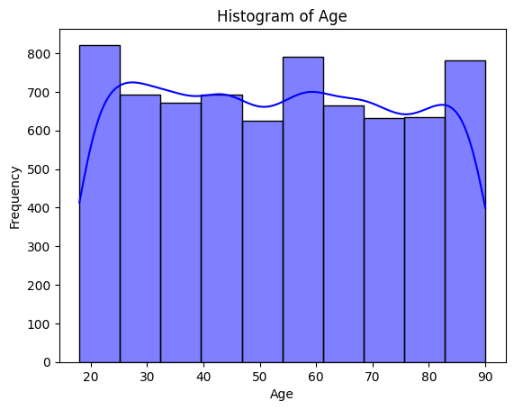
Age Observation

Slide 6
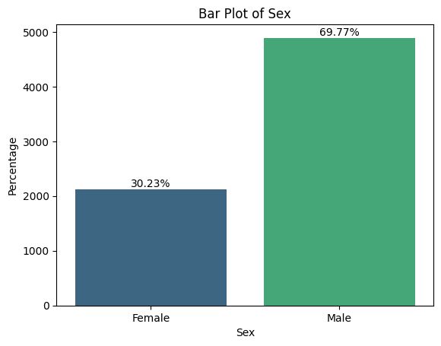
Gender

Slide 7
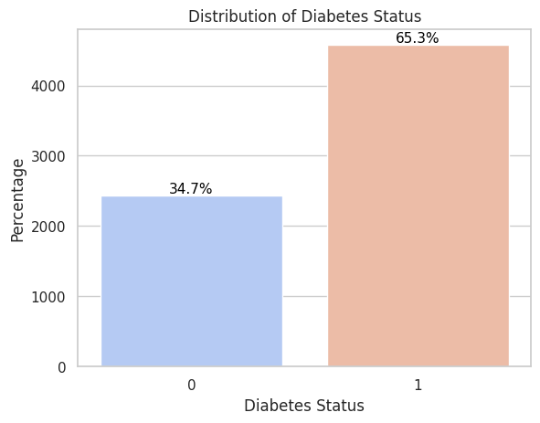
Diabetes

Slide 8
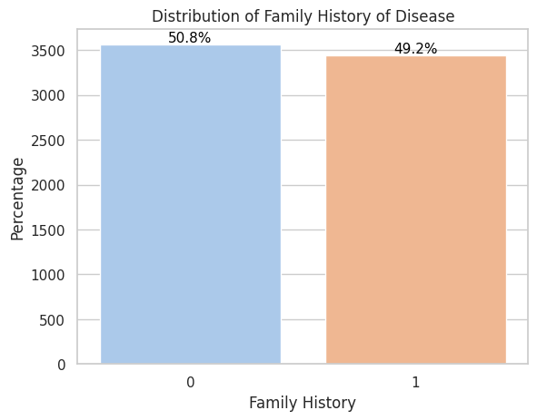
Family health History

Slide 9
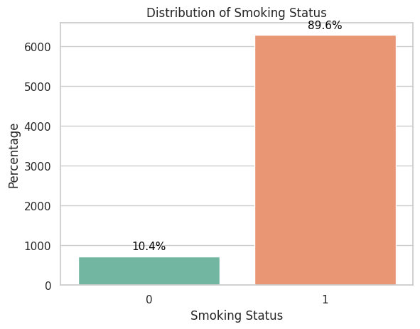

Smoking

Slide 10
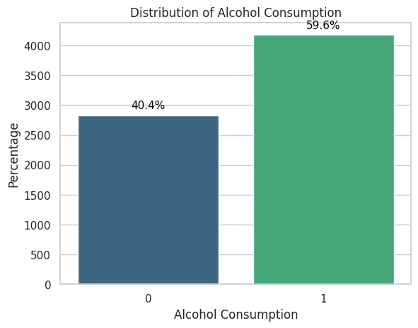

Alcohol consumption

Slide 11
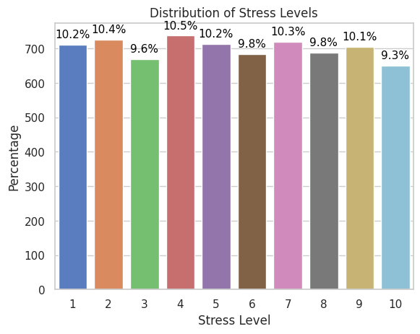

Stress

Slide 12
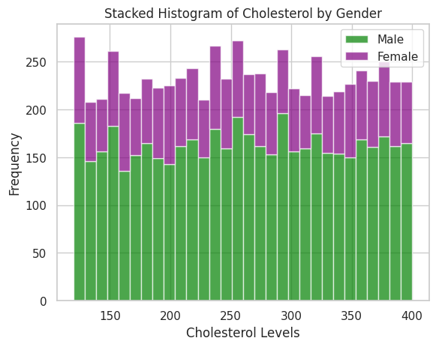

Cholesterol by gender

Slide 13
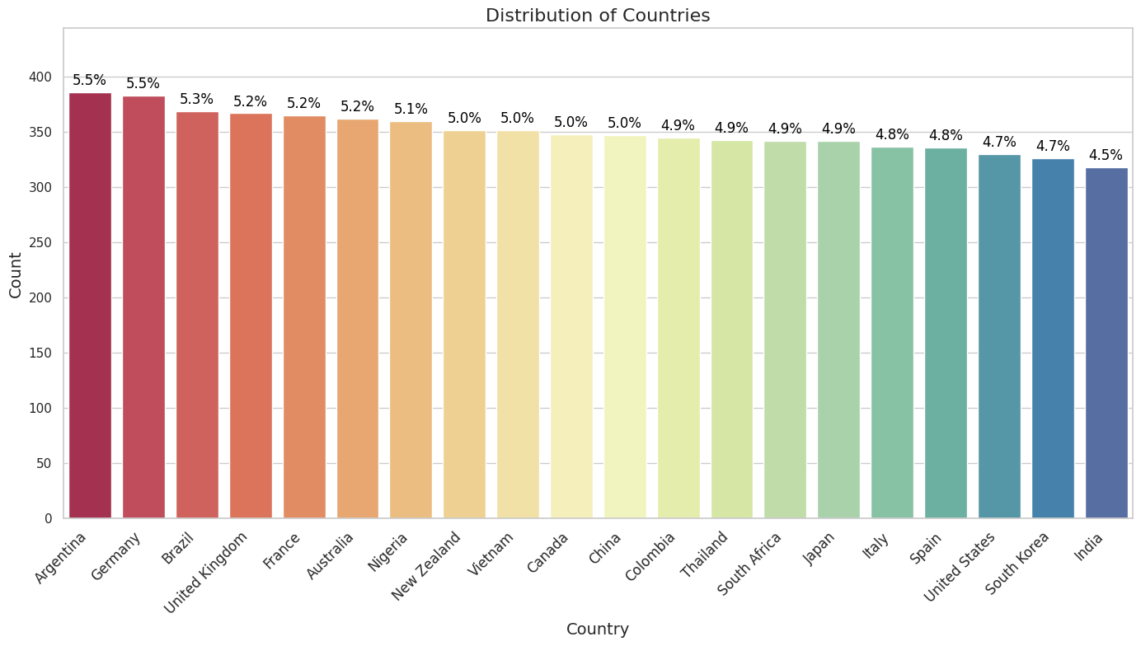

Distribution of countries

Slide 14

Modelling

Slide 15

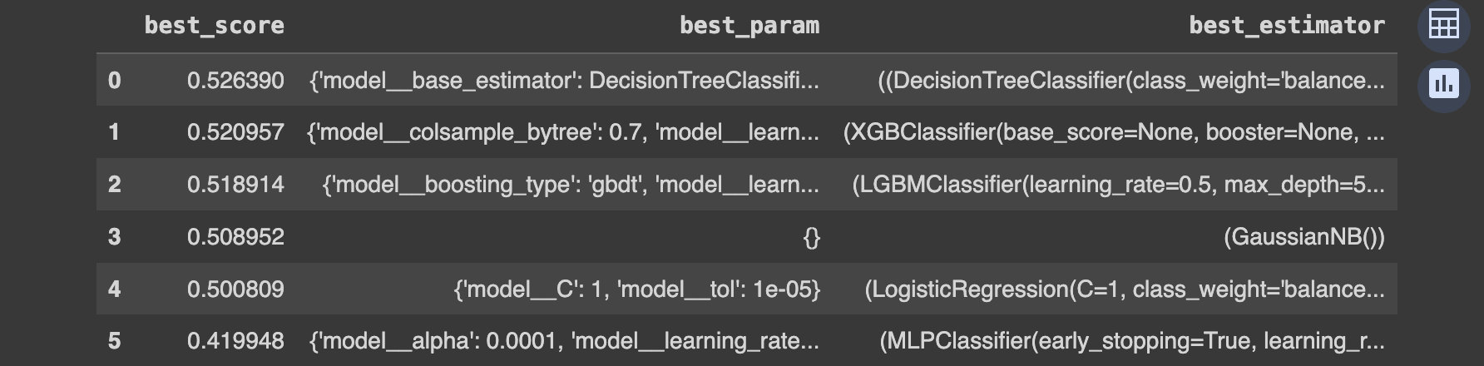
Model Tuning

Slide 16
Stacking Classifier
Score:

Slide 17
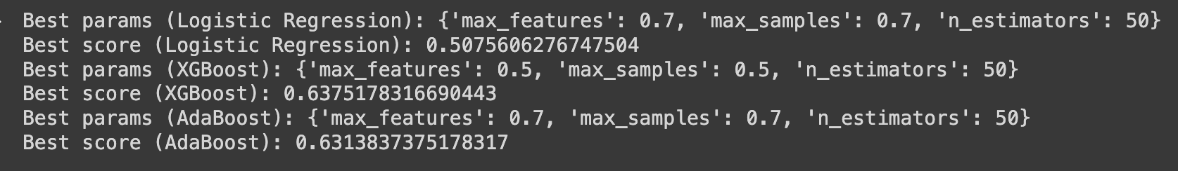
Bagging Classifier
Score:

Slide 18

Observations
* We have used logistic regression, MLP classifiers, mlp Adaboost, Xgboost, LightBGM, and naive Bayes models for the classification. Among all these models, the Adaboost model performed best with a score of 0.526390, followed by Xgboost with 0.520957 and LightBgm with 0.51.
•⁠ ⁠After hyperparameter tuning the highest score, we achieved a score of 0.52, so we then performed the ensemble methods called stacking and bagging classifiers.
•⁠ ⁠In Ensemble models, I used logistic, Adaboost and Xgboost models as the estimators.
•⁠ ⁠The stacking classifier achieved a score of 0.64, which is the highest from the models we used, and also the scores in the kaggle. While coming to the bagging classifiers, the classifier with Xgboost got a score of 0.6375, followed by Adaboost with a score of 0.6313.

Slide 19

Thank you

